Slide 1
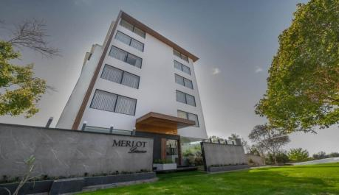
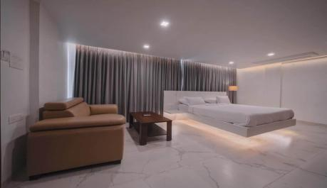
Andhra Pradesh State Financial Corporation {APSFC}, Vijayawada M/s Rajagriha Infra

Slide 2
Andhra Pradesh State Financial Corporation {APSFC}, Vijayawada M/s Rajagriha Infra
Smt. Yajjala Karunamani, and Ms. Tanya Banerjee established M/s Rajagriha Infra in the year 2019. They approached APSFC for setting up a service apartment near Beach Road M/s. Merlot Leisures and was sanctioned term loans under “General Loan Scheme” amounting to Rs.256 lakhs for construction and acquisition of furniture and machinery. The unit was established with an overall project cost of 385 lakhs. The unit is running the business on profitable lines. Smt. Yajjala Karunamani, and Ms. Tanya Banerjee are being conferred the “Best Woman Entrepreneur” award.”

Slide 3
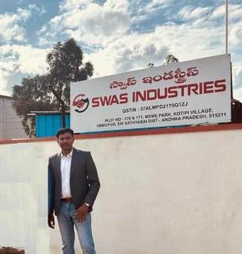
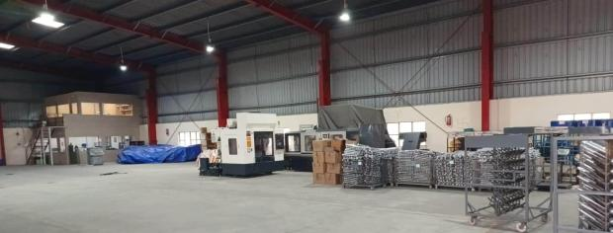
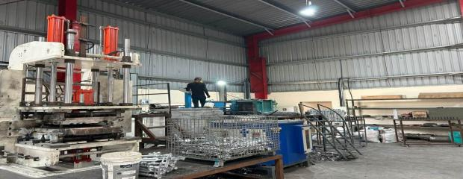
Andhra Pradesh State Financial Corporation {APSFC}, Vijayawada M/s Swas Industries
Shri Nagaraju Dasari

Slide 4
Andhra Pradesh State Financial Corporation {APSFC}, Vijayawada M/s Swas Industries
Shri Nagaraju Dasari established M/s SWAS Industries in the year 2024 with financial assistance from APSFC of Rs.300 Lakhs in the year 2022. The unit started its operations in 2024 in automobile industry. The unit is delivering the products in record time duly maintaining industry standards. They gave employment to 22 workers. The unit is established adhering to the environmental standards. Shri Nagaraju Dasari is being awarded as “Best First Generation Entrepreneur”.

Slide 5
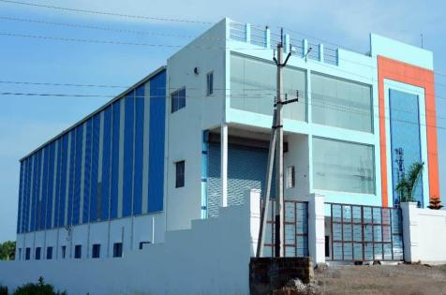
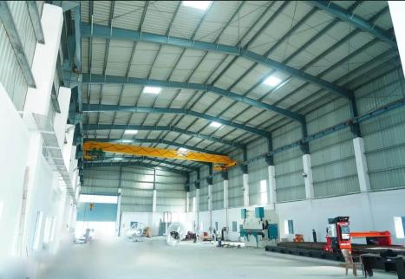
Andhra Pradesh State Financial Corporation {APSFC}, Vijayawada M/s Abeyaantrix Industries

Slide 6
Andhra Pradesh State Financial Corporation {APSFC}, Vijayawada M/s Abeyaantrix Industries
M/s Abeyaantrix Industries is a Partnership firm established by Shri Chigurupalli. Sudarsana Rao and Shri Mamidi Venkata Ramana Murthy during FY 2022-23 with financial assistance from APSFC. The unit prime Markets are Pharma Industries, Process plant engineering fabrication service, Architectural designs etc. They have expertise in manufacturing of Storage tanks, Pharma reactors, Agitators, Industrial Blenders, Stretch Manufacturing industry equipment’s etc. The unit gave employment to about 20-25 skilled and unskilled labour. Shri Chigurupalli Sudarsana Rao and Shri Mamidi Venkata Ramana Murthy have been given the “Best First Generation Entrepreneur” Award.

Slide 7
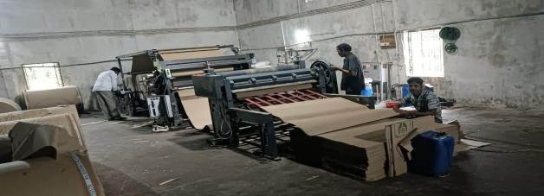
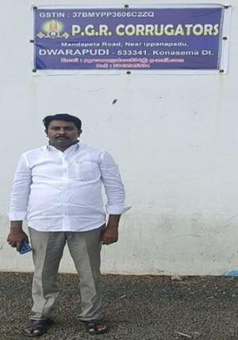
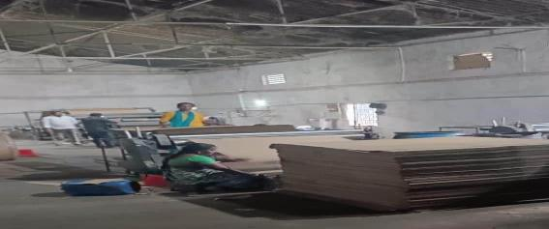
Andhra Pradesh State Financial Corporation {APSFC}, Vijayawada M/s PGR Corrugators
Shri P. Govinda Raju

Slide 8
Andhra Pradesh State Financial Corporation {APSFC}, Vijayawada M/s PGR Corrugators
M/s. PGR Corrugators is a proprietary concern established by Shri P. Govinda Raju and engaged in manufacturing of Corrugated boxes with financial assistance from APSFC. The product finds extensive use as a packing material to pack fruits, vegetables, eggs, pharma/ceramic products, packing of electronic equipment, liquor bottles and all other movable items. Some of the key clients are Parameswari Egg dealers, Tanuku, Lakshmi Poultry Farms, Tanuku, Nihitha Egg Traders, Tanuku, Radha Krishna Edible oils, Vakalapudi. The promoter is providing employment for about 40 people. Shri P. Govinda Raju is being awarded as “Best Entrepreneur”.

Slide 9
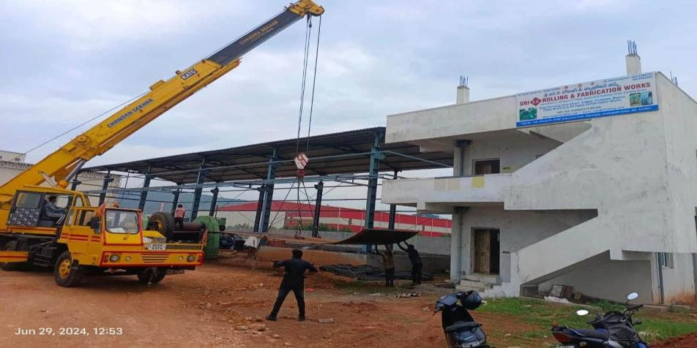
Andhra Pradesh State Financial Corporation {APSFC}, Vijayawada M/s Sri R K Rolling And Fabrication Works

Slide 10
Andhra Pradesh State Financial Corporation {APSFC}, Vijayawada M/s Sri R K Rolling & Fabrication Works
M/s. Sri R K Rolling & Fabrication was established by Shri Mongam Ramakrishna Rao and Shri Mulakala Adinarayana in the year 2015 with financial assistance of Rs.60 lakh from APSFC. The unit manufactures pressure vessels, Machinery and structural fabrications, rolling and Rotators, electric arc furnaces, barge, stacks, boilers, storage tanks, liners etc. The unit has achieved brand image in the market for delivery of material in record time duly maintaining industry standards and provided employment to 10 workers. Shri Mongam Ramakrishna Rao and Shri Mulakala Adinarayana have been given the “Best Entrepreneur” Award.

Slide 11
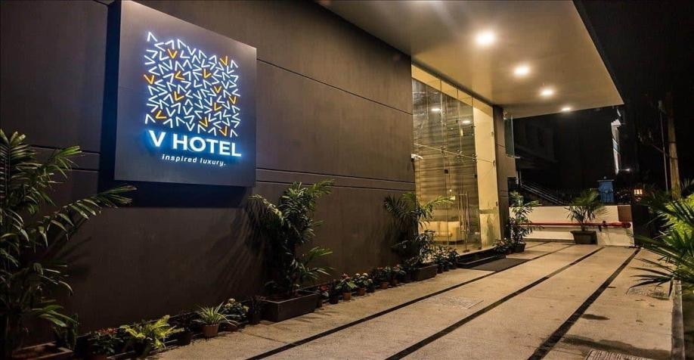
Andhra Pradesh State Financial Corporation {APSFC}, Vijayawada M/s Veeranjaneya Hotels (V Hotels)

Slide 12
Andhra Pradesh State Financial Corporation {APSFC}, Vijayawada M/s Veeranjaneya Hotels (V Hotels)
Shri Gudapati Venkateswara Rao established M/s. Veeranjaneya Hotels (V Hotels) in the year 2016 with financial assistance of Rs.500 lakhs in 2014 under “General Loan Scheme” for a janata category hotel and additional loans of Rs.600 lakhs for expansion, repairs and renovations for the hotel from APSFC. V-Hotels under his dynamic leadership, became one of the leading hotel in the city of Visakhapatnam. He is very diligent in maintaining the repayment track with the banks/financial institutions. Shri Gudapati Venkateswara Rao is being awarded as “Best Unit in service industry”.

Slide 13
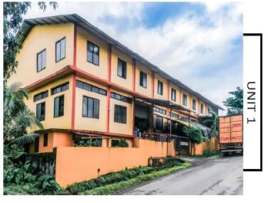
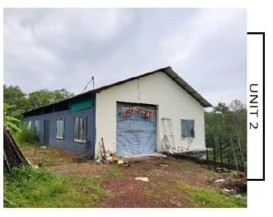
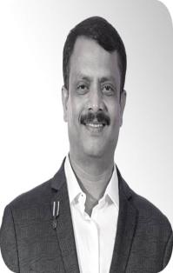
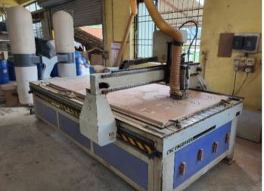
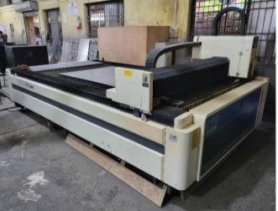
EDC Limited, Panaji Goa M/s. BAASSFX
Shri. Ranajit Patil

Slide 14
EDC Limited, Panaji Goa M/s. BAASSFX
Founded in 2007, by Shri Ranajit Patil, M/s. BaassFx is a leading designer and manufacturer of sound engineering products, creating high-quality speakers, subwoofers for Car Audio | Home Audio | Professional Audio segments. In 2018, EDC Ltd sanctioned Term loan of Rs. 85.00 Lakhs at attractive interest rate to purchase machines. Today BaassFx has build 1 Lakh + dealers network (Pan India) and is a most desired brand. Shri Ranajit Patil is being awarded as “Best First Generation Entrepreneur”.

Slide 15
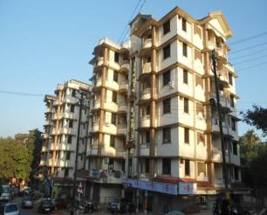
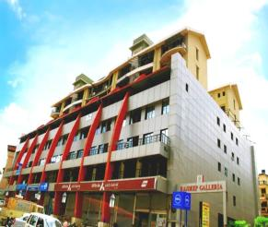
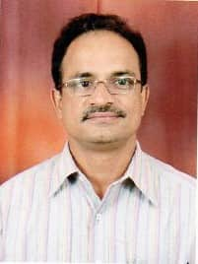
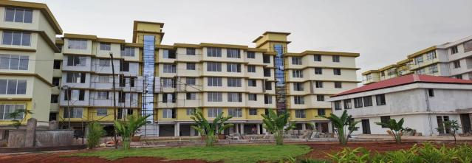
EDC Limited, Panaji Goa M/s. Raj Housing Development Pvt. Ltd
Shri. Sandip Nigalye
RAJ ENCLAVE – PROJECT OF RAJ HOUSING

Slide 16
EDC Limited, Panaji Goa M/s. Raj Housing Development Pvt. Ltd
M/s Raj Housing Development Pvt. Ltd was founded in the year 2004, by Shri. Sandip Nigalye. So far constructed more than 25 projects covering around 14 Lacs Sq. ft. of built up area in various locations in Goa. In 2019, EDC Ltd Sanctioned loan of Rs.13.35Cr & additional loan of Rs 14.00 cr was sanctioned in the Year 2024. Raj Housing Development Private Limited is one of Goa’s leading real estate development company. Shri. Sandip Nigalye is being awarded as “Best Entrepreneur”.

Slide 17
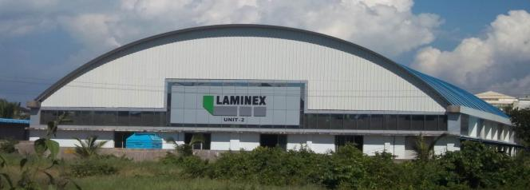
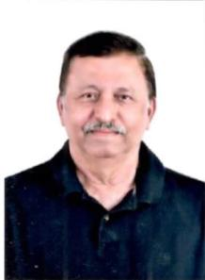
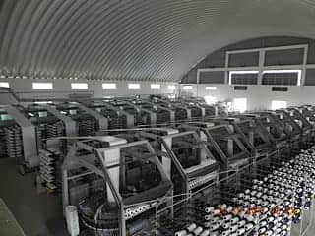
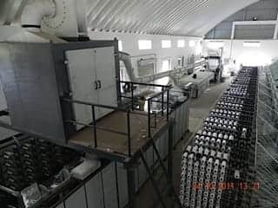
EDC Limited, Panaji Goa M/s. Laminex
Shri Parag Joshi

Slide 18
EDC Limited, Panaji Goa M/s. Laminex
M/s Laminex established by Shri Parag Vasant Joshi in 1994, has grown to become a reputed player in the Indian PP Woven Sacks industry. In 2018, EDC Ltd Sanctioned loan of Rs.2.25Cr & additional loan of Rs 1.85 cr was sanctioned in the Year 2019Operating out of a 2000 sqm. facility in Verna Industrial Estate, Goa. Laminex provides woven sacks packaging products across a diverse range of specifications to the fertiliser, sugar, cement, food grains and coking coal industries, the bedrock of our modern day society. Shri Parag Vasant Joshi is being awarded as “Best Entrepreneur”.

Slide 19
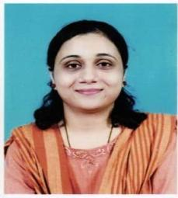
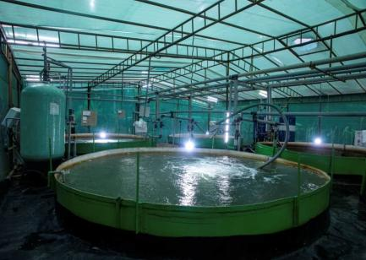
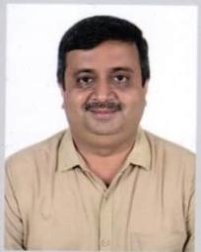
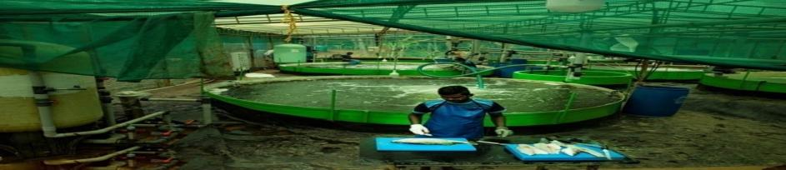
EDC Limited, Panaji Goa M/s. Zash Farms
Dr. Priya Ashish Prabhu Verlekar
Shri. Zaheer Karmali

Slide 20
EDC Limited, Panaji Goa M/s. Zash Farms
Smt. Priya Ashish Prabhu Verlekar established M/s Zash Farms, is an innovative aquaculture start-up in Goa. In 2023, EDC Ltd Sanctioned loan of Rs. 3.00 Cr. Zash Farms operates a zero-waste discharge cycle to maintain ecosystem balance while ensuring fish health in the fish farm. The project has been recognized by the National Fisheries Development Board (NFDB) as part of its "SSS: India@75" Super Success Stories, celebrating its impact during the Government of India’s ‘Azadi ka Amrit Mahotsav’. is receiving the “Most Innovative Product” award.

Slide 21
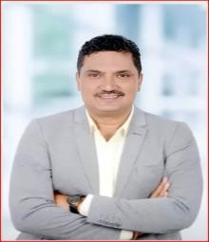
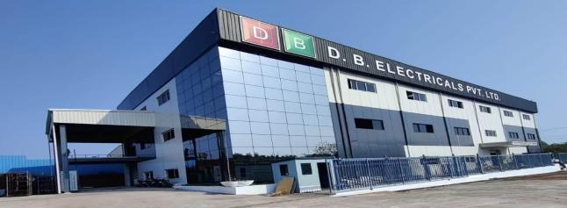
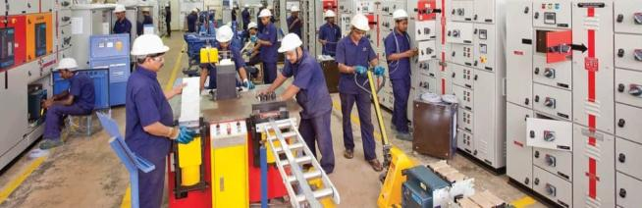
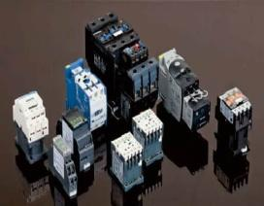
EDC Limited, Panaji Goa M/s. D B Electricals
Factory-tuem Industrial Estate, Goa
Shri Ajay Parsekar

Slide 22
EDC Limited, Panaji Goa M/s. D B Electricals
Shri Ajay Parsekar, established M/s D B Electricals in 1995, is a leading manufacturer of low tension system power and control panel for construction, manufacturing & services industries, commercial institutional, residential & service complexes in Private and Govt sector. In 2021, EDC Ltd Sanctioned loan of Rs.3.70 crore for its facility in Goa and the unit been regular in servicing the loan. M/s. DB ELECTRICALS in the past has been awarded for setting up a green production facility in Goa. Shri Ajay Parsekar is being awarded as “Most Environment Friendly Unit”.

Slide 23
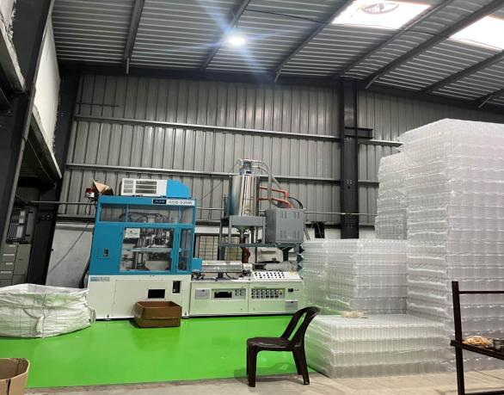
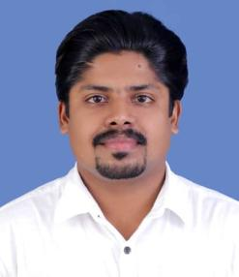
Kerala Financial Corporation {KFC}, Thiruvananthapuram M/s AVK Plastic
Shri Kasyap A V

Slide 24
Kerala Financial Corporation {KFC}, Thiruvananthapuram M/s AVK Plastic
Shri Kasyap A V established M/s AVK Plastic in the year 2011 and took financial assistance from Rs.117 lakh from KFC for construction and new machinery. The unit is engaged in the manufacturing pet bottles and jars. Almost all packaged drinking water, beverages and Ayurveda medicine manufacturing units uses the pet bottles in the large quantity to the market their product. Shri Kashyap AV is being awarded as “Best First Generation Entrepreneur”.

Slide 25
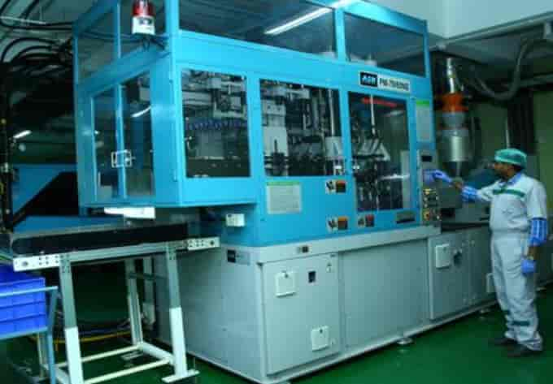
Kerala Financial Corporation {KFC}, Thiruvananthapuram M/s Mallelil Industries Pvt Ltd.

Slide 26
Kerala Financial Corporation {KFC}, Thiruvananthapuram M/s Mallelil Industries Pvt Ltd.
M/s Mallelil Industries Pvt. Ltd. established by Shri Sreedharan Nair Raghavan Pillai in the year 2007 with financial assistance of Rs.3970 lakhs from KFC. M/s Mallelil Industries Pvt Ltd. is manufacturing pet bottles and Metal crushing unit. Shri Sreedharan Nair Raghavan Pillai is being awarded as “Best Entrepreneur”.

Slide 27
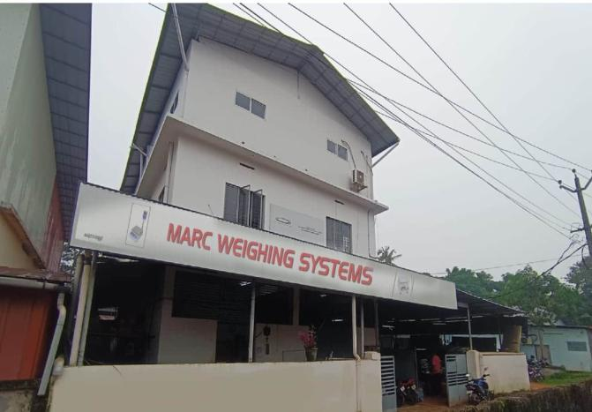
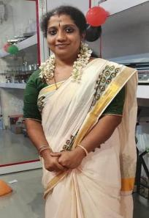
Kerala Financial Corporation {KFC}, Thiruvananthapuram M/s Marc Weighing Systems
Smt. Lija T

Slide 28
Kerala Financial Corporation {KFC}, Thiruvananthapuram M/s Marc Weighing Systems
Smt. Lija T established M/s Marc Weighing Systems in the year 2011 with financial assistance of Rs. 87 lakhs from KFC. The unit is fastest growing weighing machine brand in India & manufacture equipment with cutting-edge technologies that meets all standards in the weighing and printing machine markets. M/s Marc Weighing Systems has a world class infrastructure facility to carry out hassle-free operations to produce high quality products, they have their own moulding metal fabrication and powder coating units. Smt. Lija T is receiving the “Best Women Entrepreneur” Award.

Slide 29
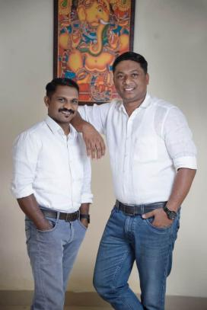
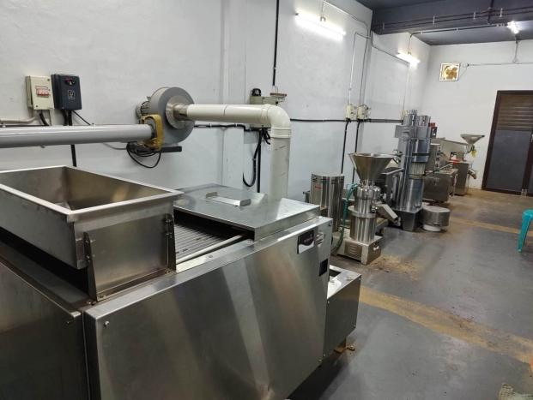
Kerala Financial Corporation {KFC}, Thiruvananthapuram M/s Caramin Extract
Shri Ajith T T &
Shri Arun Kamal

Slide 30
Kerala Financial Corporation {KFC}, Thiruvananthapuram M/s Caramin Extract
M/s Caramin Extract partnership firm established by Shri Ajith T T and Shri Arun Kamal in the year 2021 taken financial assistance of Rs. 57.41 lakhs from KFC. In the 1st Phase their products viz. cocoa powder & cocoa butter are produced in the factory and sold to meet external requirements. The Unit is engaged in the production and sale of cocoa products. The company procures cocoa from a group of 200 farmers. Shri Ajith T T and Shri Arun Kamal were being conferred with “Most Environmental Friendly Unit” award.

Slide 31
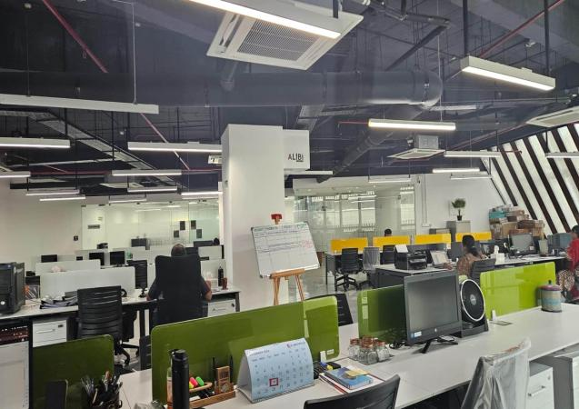

Kerala Financial Corporation {KFC}, Thiruvananthapuram M/s Alibi Global Private Ltd.
Ms. Sowmya Balan

Slide 32
Kerala Financial Corporation {KFC}, Thiruvananthapuram M/s Alibi Global Private Ltd.
M/s Alibi Global Private Ltd. established by Ms. Sowmya Balan in the year 2020 and taken financial assistance of Rs.5 Crore from KFC. Alibi is India’s First NABL Accredited Cyber Forensic Private Lab; Cyber Forensics & Defence Solutions with operation centers at Chennai & New Delhi, led by well qualified industry experts. The unit has obtained ISO/IEC 17025:2017 & ISO/IEC 27001:2013 certification. Alibi is the MoU partner of IIT Bombay, IIT Kottayam and many other Universities in the country, for technology partnership and also for imparting digital forensics & cyber security training to the students & faculties. Ms. Sowmya Balan is being conferred with the “Most Innovative product” Award.

Slide 33
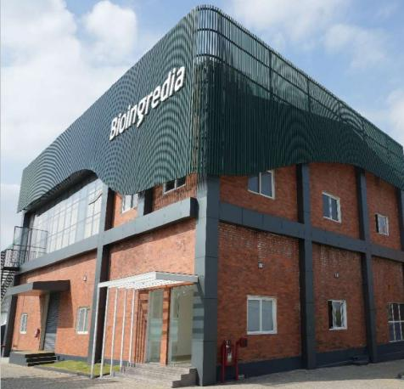
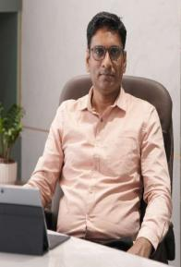
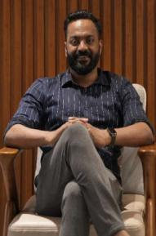
Kerala Financial Corporation {KFC}, Thiruvananthapuram M/s Bio Ingredia Naturals Pvt Ltd
Shri Arjun Mathew
Shri Jose K Mathew

Slide 34
Kerala Financial Corporation {KFC}, Thiruvananthapuram M/s Bio Ingredia Naturals Pvt Ltd
Shri Jose K Mathew & Shri Arjun Mathew established M/s Bio Ingredia Naturals Pvt. Ltd. in the year 2015 and took financial assistance of Rs.773.00 Lakhs from KFC. The unit manufactures oleoresin, essential oils, nutraceuticals & natural colours. The unit has obtained GFSI(Global Food Safety Initiative) certification in 2022 and in the process of obtaining SEDEX (Supplier Ethical Data Exchange) Certification. They are approved by USFDA (United State Food and Drug Administration). They are developing the Industrial premises MIYAWAKI Forest comprising of 1000 trees. Shri Jose K Mathew & Shri Arjun Mathew are being conferred with the “Best Exporting Unit” Award.

Slide 35
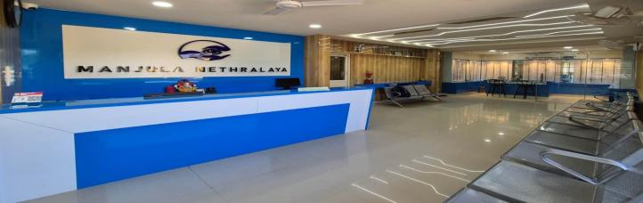
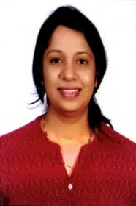
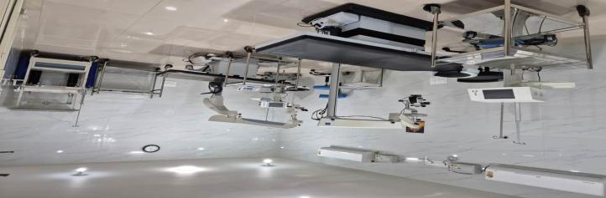
Karnataka State Financial Corporation {KSFC}, Bangalore M/s Manjula Netralaya [Eye hospital]
Dr. Manjula B N

Slide 36
Karnataka State Financial Corporation {KSFC}, Bangalore M/s Manjula Netralaya [Eye hospital]
Dr. Manjula B N established M/s Manjula Netralaya [Eye hospital] in the year 2016 with financial assistance of Rs.57.00 Lakhs from KSFC. The hospital started in 2016 with a small out patient examination room an operating theatre in a 800sq feet space. The unit has expanded and are currently housed in a 3 floors 4500 sq feet building , providing out patient, in patient and pan ophthalmic surgical services and treated more than 40000 out patients and operated conducted 2000 surgeries. The unit has conducted several screening eye camps under Yeshasvini, SKDRDP, Lions club etc. The unit currently employed Totally 07 staff.

Slide 37
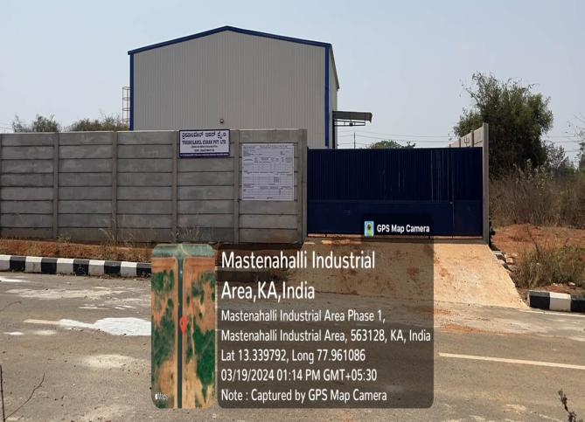
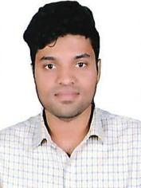
Karnataka State Financial Corporation {KSFC}, Bangalore M/s Trishula Vel Eshan Pvt. Ltd. [Ion Battery Unit]
Shri Santhosh Kumar J

Slide 38
Karnataka State Financial Corporation {KSFC}, Bangalore M/s Trishula Vel Eshan Pvt. Ltd. [Ion Battery Unit]
Shri Santhosh Kumar J established M/s.Trishula Vel Eshan Pvt. Ltd. [Ion Battery Unit] in the year 2020 with financial assistant of Rs.16.650 from KSFC. The unit manufactures Chemical & Chemical Product, Recycling of Scrap / end of life lithium ion battery. The unit is Karnataka’s Ist lithium ion battery recycler. The unit received several awards Best emerging startup in batter Re-commerce circular economy vision awards – 2023; HDFC Parivarthan Grant 2023; & Startup India Seed Fund 2022 etc. Its major clients are HBL, Exicam bounce, yulu, River mobility, simple energy, cashify and more. They also exports to Philippines Manila (Direct) and South Korea (through South Korean Counter Part in India).

Slide 39

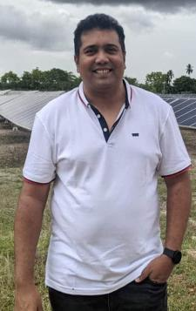
Karnataka State Financial Corporation {KSFC}, Bangalore M/s Gorich Energy Pvt. Ltd.,[Solar Energy]
Shri M V Rajaiah

Slide 40
Karnataka State Financial Corporation {KSFC}, Bangalore M/s Gorich Energy Pvt. Ltd.,[Solar Energy]
M/s Gorich Energy Pvt. Ltd.,[Solar Energy ] established by Shri M V Rajaiah in the year 2015 with financial assistance of Rs.575.00 Lakhs from KSFC. The unit is family based private limited company started to generate solar power by establishing solar panel unit and Generate 1 Megawatt solar power using ground mount solar system support by tracker and solar power supplied to Chamarajaynagar Electricity Supply Company.

Slide 41


Karnataka State Financial Corporation {KSFC}, Bangalore M/s Hotel Sky bird

Slide 42
Karnataka State Financial Corporation {KSFC}, Bangalore M/s Hotel Sky bird
M/s Hotel Sky bird established by Smt. Mamatha in the year 2020 with the financial assistance of Rs.200 Lakhs from KSFC. The unit has 26 Ac Rooms & Restaurants and started business near Bengaluru and Mangaluru highway. The hotel and restaurant are running successfully. The hotel provide quality room service and food facility to local and foreign tourists. The major tourist attractive places are Belur, Halibeedu and Sharavanabelagula. The hotel gave employment to 18 Professional & supporting staff.

Slide 43



Karnataka State Financial Corporation {KSFC}, Bangalore M/s Karnataka E N T Hospital & Research Centre
Dr. Prahlada N B

Slide 44
Karnataka State Financial Corporation {KSFC}, Bangalore M/s Karnataka E N T Hospital & Research Centre
Dr. N B Prahalada established M/s Karnataka E N T Hospital & Research Centre in the year 2010 with financial assistance of Rs.9 Crores from KSFC. The unit is Ear, Nose & Throat specialized hospital. The unit till date treated around 4.50 lakhs out patients are treated and 2.30 lakhs ENT patients are operated successfully. Basically, this is an Education and Training Academy 120 Indian and 60 foreign students are successfully completed graduation etc. 56 National and International Seminars were organized for past 20 years. Presently 3 Professional Doctors and 15 Supporting Staff are working in the hospital.

Slide 45



Karnataka State Financial Corporation {KSFC}, Bangalore M/s Maruti Power Services [Electrical Service station]
Shri Manjunath M & Shri Lingaraj Hugar

Slide 46
Karnataka State Financial Corporation {KSFC}, Bangalore M/s Maruti Power Services [Electrical Service station]
M/s Maruthi Power Services is a partnership firm established by Shri Manjunath M and Shri Lingaraj Hugar in the year 2021 with the financial assistance of Rs.295 Lakhs from KSFC. The unit offer specilized services for rotating machines such as AC / DC / HT / LV motors alternators, generators and transformers ensuring top-quality repairs, rewinding and overhauling for medium & high voltage machines up to 50 MW Capacity in sugar factory and power stations. Nirani Sugars, Shree Renuka Sugars, Jamkhandi Sugars, Bhoruka Power Corporation, Gokak Power are its major clients. The unit gave employment to 40 persons.

Slide 47




PIPDIC, Puducherry M/s Bonn Stering Bio Science LLP
Shri R. Bharathidhasan

Slide 48
PIPDIC, Puducherry M/s Bonn Stering Bio Science LLP
Shri R. Bharathidhasan established M/s Bonn Stering Bio Science LLP a leading pharmaceutical company in Puducherry in March 2006 with assistance from PIPDIC. The unit was allotted 5 industrial plots and one additional piece of land at Thirubuvanai Industrial Estate during 2005, 2006, 2013, 2021, 2022 and 2024 and manufactures wide range of pharmaceutical products like Tablets, Capsules, Syrups, Suspensions, Dry syrups, Sachets, Ointments, and Gels delivering excellence and innovation in the healthcare sector. The Company have 150 highly skilled and experienced professionals. The unit also obtained Good Manufacturing Practice (GMP) and ISO 9001:2015 certifications. Shri R. Bharathidhasan is being Awarded as “Best Entrepreneur”.

Slide 49



PIPDIC, Puducherry M/s Praba’s Vcare Health Clinic Pvt. Ltd.
Smt. Carolin Prabha Arokiyasamy

Slide 50
PIPDIC, Puducherry M/s Praba’s Vcare Health Clinic Pvt. Ltd.
Smt. Carolin Prabha Arokiyasamy established M/s Praba’s Vcare Health Clinic Pvt. Ltd. formerly known as Vcare Pharcos in 2008 with 18,000 Sq. ft built up area is a group company of VCare Group with assistance from PIPDIC. The facility manufactures personal care cosmetics for Hair care and Skincare such as Shampoo, Conditioner, Serum, Hair Spray, Herbal Powder etc. and employs 50 people. The unit has obtained GMP and ISO 9001:2015 certifications. They also support in R&D; Packaging development and Artwork development for various customers. Smt. Carolin Prabha Arokiyasamy is getting the “Best Women Entrepreneur” Award.

Slide 51



PIPDIC, Puducherry M/s Neer Plast
Smt. Suganya Sakthivel

Slide 52
PIPDIC, Puducherry M/s Neer Plast
M/s Neer Plasts established by Smt. Suganya Sakthivel in the year 2020 with assistance from PIPDIC and was allotted one plot at growth centre, Karaikal during 2018. The unit involved in manufacturing of “water storage tanks” registered trademark brand name of “NEER”. With an initial financial assistance of Rs. 45 lakhs from the Standup India scheme. M/s Neer Plasts catered for water storage tanks ranging from 300 Liters to 1000 Liters and utilising 100% virgin raw materials with food-grade quality. The unit has launched new products such as the Efficient Drainage Conical Tank for Residential Water Storage. Smt. Suganya Sakthivel is being awarded under the “Best First Generation Entrepreneur” category.

Slide 53



PIPDIC, Puducherry M/s Waaree Renewable Technologies Ltd.
Shri Viren Chimanlal Doshi

Slide 54
PIPDIC, Puducherry M/s Waaree Renewable Technologies Ltd.
Shri Viren Chimanlal Doshi established M/s Waaree Renewable Technologies Ltd. (WRTL) involved in manufacturing of “Solar Power Project” with assistance from PIPDIC and was allotted with 55 acres of land at Growth Centre, Karaikal during 2019 and 2021. The unit supports India’s renewable energy goals and has expanded internationally delivering sustainable energy solutions for residential and industrial sectors. M/s Waaree Renewable Technologies Ltd. is developing 10MW solar photovoltaic (PV) power project and employs about 50 people. Shri Viren Chimanlal Doshi is being conferred with “Most Environmental Friendly Unit” Award.

Slide 55





Tamilnadu Industrial Investment Corp. Ltd. {TIIC}, Chennai M/s Hemagni Build Pro Industries
MS. G. SIREESHA

Slide 56
Tamilnadu Industrial Investment Corp. Ltd. {TIIC}, Chennai M/s Hemagni Build Pro Industries
M/s. Hemagni Build-Pro Industries is a Proprietorship firm established by Smt. G. Sireesha in the year 2020 with the financial assistance from TIIC under "NEEDS Scheme". The unit started with one Roof Sheet Roll forming machine & CNC Automatic Welding Machine and with further assistance from TIIC created the complete PEB Manufacturing facility to meet the raising demand of clients. M/s. Hemagni Build-Pro Industries have an installed Capacity of 150 MT/Month and employed 60 members. Smt. G. Sireesha is being Awarded as “Best First Generation Entrepreneur”.

Slide 57



Tamilnadu Industrial Investment Corp. Ltd. {TIIC}, Chennai M/s Sri Vethaa Dairy Pvt. Ltd.
SHRI N. RAMESH

Slide 58
Tamilnadu Industrial Investment Corp. Ltd. {TIIC}, Chennai M/s Sri Vethaa Dairy Pvt. Ltd.
Shri N. Ramesh established M/s Sri Vethaa Dairy Pvt. Ltd., a blue-chip company was incorporated under the Ministry of Corporate Affairs and commenced production in 2016 with financial assistance from TIIC. With more than 500 retail outlets across Tamil Nadu, the company has two production plants with Installed Capacity of 6 Lakhs litres per day. The company has more than 250 trained direct employees, 3000 collection agents and 1500 Distributors and Agents. 20,000 farmers and their cows are associated with the company. Shri N. Ramesh is being awarded as “Best Entrepreneur”.

Slide 59




Tamilnadu Industrial Investment Corp. Ltd. {TIIC}, Chennai M/s Shree Vari Multiplast India

Slide 60
Tamilnadu Industrial Investment Corp. Ltd. {TIIC}, Chennai M/s Shree Vari Multiplast India Pvt. Ltd.
M/s Shree Vari Multiplast India Pvt. Ltd. established in the year 1999 by Shri V. Senthil Murugan started manufacturing of plastic household products – chairs & tables with High Precision machinery & Power efficient machinery and availed financial assistance of Rs 383.73 lakhs in the year 2016 from TIIC. The Company has established a well-known Brand – “V.V National”. The unit has obtained ISO 9001:2015 certifications. Shri V. Senthil Murugan is being Awarded as “Best Entrepreneur”.

Slide 61




Tamilnadu Industrial Investment Corp. Ltd. {TIIC}, Chennai M/s A V Packaging Industries

Slide 62
Tamilnadu Industrial Investment Corp. Ltd. {TIIC}, Chennai M/s A V Packaging Industries
Smt. P. Ashwarya established M/s AV Packaging Industries in the year 2018 with financial assistance of Rs. 311.38 lakhs in the year 2020 from TIIC. The unit, engaged in manufacturing plastics and polythene bags/films. The unit has obtained ISO 9001:2015 certifications and engages in eco-friendly polythene manufacturing, stretch wrap films, and air bubble sheets for packaging. Smt. P. Ashwarya is getting the “Best Women Entrepreneur” award.

Slide 63



Tamilnadu Industrial Investment Corp. Ltd. {TIIC}, Chennai M/s Jaya Hospital

Slide 64
Tamilnadu Industrial Investment Corp. Ltd. {TIIC}, Chennai M/s Jaya Hospital
Dr. (Smt.) S. Pavalakodi established Jaya Hospital with financial help from TIIC. Jaya Hospital is a multi-speciality 50 bedded hospital with latest medical equipments, eminent medical and paramedical team at an easily accessible place for trauma and emergency care with pollution free environment. They have 24 hrs Team of Doctors, paramedicals for Trauma & Emergency management, Lab, X-Ray Facilities & highly equipped- 3 operation theatres are available. Affiliation to health insurance groups viz. ICICI, Prudential, ICICI Lombard, State Bank, TTK, MD India, Bajaj Allianz, Tata AIG etc. Dr. (Smt.) S. Pavalakodi is being conferred with the “Best unit in Service Industry” Award.

Slide 65




Tamilnadu Industrial Investment Corp. Ltd. {TIIC}, Chennai M/s Hameed Marine Pvt. Ltd.
SHRI M. SHAHUL HAMEED

Slide 66
Tamilnadu Industrial Investment Corp. Ltd. {TIIC}, Chennai M/s Hameed Marine Pvt. Ltd.
M/s Hameed Marine Pvt. Ltd. established by Shri M. Shahul Hameed in the year 2014 with financial assistance of Rs.2,085.71 lakhs from TIIC. The unit involved in food manufacturing, specifically seafood processing. M/s Hameed Marine Pvt. Ltd. ranks among India’s top three fishmeal exporters over the past two years. The unit has obtained ISO 9001:2015, ISO 14001:2015, FSSC 22000, GMP+, and HACCP certifications with technology upgrades undertaken. Shri M. Shahul Hameed is receiving the “Best Exporting Unit” Award.

Slide 67



Tamilnadu Industrial Investment Corp. Ltd. {TIIC}, Chennai M/s Jheeva Rekhaa Textiles

Slide 68
Tamilnadu Industrial Investment Corp. Ltd. {TIIC}, Chennai M/s Jheeva Rekhaa Textiles
M/s Jheeva Rekhaa Textiles is a partnership firm established in the year 1997 by Shri A. R. Barath Kumar with financial assistance from TIIC. The firm specialist in Airjet, Rapier & Ruti ‘c’ Fabrics (Shuttle less & Shuttle Looms) initial year with 12 Ruti-C Looms monthly production was 30,000 Mtrs/Month. M/s Jheeva Rekhaa Textiles installed 80 Toyota Airjet Looms with all other supportive machineries and its monthly production is around 85.5 Lakhs mtrs/ Month in the year 2024. Shri A. R. Barath Kumar is being conferred with “Most Environment Friendly Unit” Award.

Slide 69




Assam Financial Corporation {AFC}, Guwahati M/s Baruah Concrete Industry
Shri Atin Kumar Baruah

Slide 70
Assam Financial Corporation {AFC}, Guwahati M/s Baruah Concrete Industry
M/s Baruah Concrete Industry established in 1997 by Sri Atin Kumar Baruah with financial assistance of Rs.95.70 lakhs over the years from AFC. The unit specializes in producing stone chips and stone dust, with raw materials sourced from nearby districts such as Golaghat, Sivasagar, and Jorhat. Recognized for its sustained growth, environmental efforts, and employee welfare initiatives, the unit employs five local youths and provides facilities such as potable water, toilets, and resting spaces for workers. Notably, there are no similar units within a 10 km radius, giving it a strategic advantage in the region. Shri Atin Kumar Baruah is being awarded as “Best First Generation Entrepreneur”.

Slide 71





Assam Financial Corporation {AFC}, Guwahati M/s Kapili Hospital & Research Center Pvt. Ltd.
Smt. Dipti Saikia
Smt. Kalpana Baruah
Dr. Bibha Devi
Smt. Nikumoni Mahanta

Slide 72
Assam Financial Corporation {AFC}, Guwahati M/s Kapili Hospital & Research Center Pvt. Ltd.
M/s Kapili Hospital & Research Centre established by Smt. Dipti Saikia; Smt. Kalpana Baruah; Dr. Bibha Devi & Smt. Nikumoni Mahanta in the year 2003. Term Loan of Rs.500 crore was sanctioned by AFC in the year 2023. The unit is a 40 bedded Healthcare unit with modern medical diagnostic & treatment facilities. The hospital is now operating from a 5 storied RCC building. The facilities of CT Scan, MRI and Dialysis are proposed in the subsequent phases of the expansion program of the hospital unit. Smt. Dipti Saikia; Smt. Kalpana Baruah; Dr. Bibha Devi & Smt. Nikumoni Mahanta are being conferred with the “Best Woman Entrepreneur” award.”

Slide 73



Assam Financial Corporation {AFC}, Guwahati M/s Leela Guest House
Shri Ravi Bhushan Mishra & Shri Krishan Kant Mishra

Slide 74
Assam Financial Corporation {AFC}, Guwahati M/s Leela Guest House
M/s Leela Guest House established by Shri Ravi Bhushan Mishra & Shri Krishan Kant Mishra in the year 2018 with the financial assistance of Rs.75 lakhs from AFC. The hotel has 7 double bedded AC rooms and 6 triple bedded AC Rooms and also provides Internet facility; EPABX System; Tour Package & Travel Counter. The hotel unit is running successfully since inception and its track record of repayment with the Corporation is very satisfactory without any default since inception. Shri Ravi Bhushan Mishra & Shri Krishan Kant Mishra are being conferred with “Best Entrepreneur” award.

Slide 75




Assam Financial Corporation {AFC}, Guwahati M/s R.J. Industries & Construction
Shri Jibon Keot &
Shri Rinku Ranjan Saikia

Slide 76
Assam Financial Corporation {AFC}, Guwahati M/s R.J. Industries & Construction
M/S R.J. Industries & Construction is a partnership firm established by Shri Rinku Ranjan Saikia and Shri Jibon Keot, in the 24th March 2023 with financial assistance from AFC. The unit specializes in stone crushers. Shri Rinku Ranjan Saikia and Shri Jibon Keot are being conferred with “Best Entrepreneur” award.

Slide 77


Assam Financial Corporation {AFC}, Guwahati M/s Hotel Padma Plaza
Dr. (Shri) Biren Padun

Slide 78
Assam Financial Corporation {AFC}, Guwahati M/s Hotel Padma Plaza
Dr. (Shri) Biren Padun established M/s Hotel Padma Plaza in the year 2017 with financial assistance from AFC. M/S Hotel Padma Plaza, is located on Main Road, Silapathar, near Essar Petrol Depot in Dhemaji, Assam. The unit works in service industry. Dr. (Shri) Biren Padun is being awarded as “Best Unit in service industry”.

Slide 79

Assam Financial Corporation {AFC}, Guwahati M/s M.G. Plaza
Smt. Meera Devi

Slide 80
Assam Financial Corporation {AFC}, Guwahati M/s M.G. Plaza
M/s M G Plaza established by Smt. Meera Devi in the year 2018 with financial assistance of Rs.1.25 crore from AFC. The unit is classified as a micro enterprise for the year 2023-24. M/s M G Plaza is engaged in real estate activities, provides services involving properties owned or leased and located in Kamargaon, Biswanath Chariali, Assam. Smt. Meera Devi is being awarded as “Best Unit in service industry”.

Slide 81


Assam Financial Corporation {AFC}, Guwahati M/s B. R. Enterpise
Shri Rajib Kalita

Slide 82
Assam Financial Corporation {AFC}, Guwahati M/s B. R. Enterpise
M/s B. R. Enterprise, a proprietorship established by Shri Rajib Kalita, with financial assistance of Rs.75 lakh from AFC. He operates a five-storied commercial complex (B+G+4) at Chandrapur Road, Narengi, Guwahati. The basement is dedicated to car parking, while the ground, first, second, and third floors are rented to M/s Vishal Mega Mart, with the fourth floor available for commercial halls, offices, or restaurants. The firm has maintained a regular repayment history. The project was developed jointly with M/s Aakar Initiative, promoted by his cousin, Shri Bijan Kalita. Shri Rajib Kalita is being awarded as “Best Unit in service industry”.

Slide 83


Assam Financial Corporation {AFC}, Guwahati M/s Aakar Initiative
Shri Bijan Kalita

Slide 84
Assam Financial Corporation {AFC}, Guwahati M/s Aakar Initiative
M/s Aakar Initiative, is a proprietorship concern promoted by Shri Bijan Kalita, established in 2019 with financial assistance from AFC. Shri Kalita has been associated with Aakar Vision and Communication; Aakar Initiative & Aakar Interior. The complex includes a basement for parking (1,812 sq. ft.), a ground-floor shopping area (1,812 sq. ft.), and upper floors for offices, halls, or restaurants (1,920 sq. ft. each). The project was developed jointly with M/s B. R. Enterprises, promoted by his cousin, Shri Rajib Kalita. Shri Bijan Kalita is being awarded as “Best Unit in service industry”.

Slide 85



Rajasthan Financial Corporation {RFC}, Jaipur M/s Jainsons Agro Industries
Shri Manish Jain

Slide 86
Rajasthan Financial Corporation {RFC}, Jaipur M/s Jainsons Agro Industries
Shri Manish Jain established M/s Jainsons Agro Industries on May 13, 2016 with financial assistance of Rs. 90 lakhs under Yuva Udyamita Protsahan Yojana (YUPY) from RFC. The unit is engaged in wholesale trading, particularly of agricultural raw materials like cereals, pulses, and other agro products. The company operates as a small enterprise under India's MSME classification.

Slide 87


Rajasthan Financial Corporation {RFC}, Jaipur M/s Navkar Agricom
Ms. Priyanka Jain

Slide 88
Rajasthan Financial Corporation {RFC}, Jaipur M/s Navkar Agricom
Ms. Priyanka Jain established M/s Navkar Agricom with financial assistance of Rs. 90 lakhs under Yuva Udyamita Protsahan Yojana (YUPY) from RFC. The unit is engaged in the agricultural sector, focusing on various agro-based industries, including the processing and distribution of agricultural products.

Slide 89


Rajasthan State Industrial Development & Investment Corp. Ltd. {RIICO}, Jaipur M/s Universal Autofoundry Ltd.
Shri Vimal Chand Jain

Slide 90
Rajasthan State Industrial Development & Investment Corp. Ltd. {RIICO}, Jaipur M/s Universal Autofoundry Ltd.
M/s Universal Autofoundry Ltd., established by Shri Vimal Chand Jain in 1971, specializes in the manufacturing of Grey Iron, Ductile Iron, and SG Iron castings with financial assistance from RIICO. The unit serves diverse industries such as automobiles, agriculture, railways, and earth movers. Shri Vimal Chand Jain, with over five decades of experience, played a pivotal role in transitioning the business from a partnership firm to a public limited company. The unit is recognized for its innovation, high-quality production, and global presence, with a casting capacity of 42,000 metric tons annually​. Shri Vimal Chand Jain is being awarded as “Best Entrepreneur”.

Slide 91

Rajasthan State Industrial Development & Investment Corp. Ltd. {RIICO}, Jaipur M/s Balar Synthetics Pvt. Ltd.

Slide 92
Rajasthan State Industrial Development & Investment Corp. Ltd. {RIICO}, Jaipur M/s Balar Synthetics Pvt. Ltd.
M/s Balar Synthetics Pvt. Ltd. was established in 1996 by Shri Suresh Kumar Jain in Bhilwara, Rajasthan, a key hub for the textile industry with financial assistance from RIICO. The unit specializes in manufacturing synthetic fabrics, particularly polyester viscose (PV) and polyester suiting fabrics, with a significant production capacity. Shri Suresh Kumar Jain is being awarded as “Best Entrepreneur”.

Slide 93


Rajasthan State Industrial Development & Investment Corp. Ltd. {RIICO}, Jaipur M/s Sankalp International
Shri Girish Kumar Agarwal

Slide 94
Rajasthan State Industrial Development & Investment Corp. Ltd. {RIICO}, Jaipur M/s Sankalp International
M/s Sankalp International, was established by Shri Girish Kumar Agarwal in 1999 with financial assistance from RIICO and is manufacturer and exporter of wooden furniture and handicrafts. The unit is now operating from a 5-acre facility with four factories and recognized as a "Star Export House" by the government The firm is a major exporter to USA, Europe, and Australia​. M/s Sankalp International has received multiple awards including presidential awards for the highest export turnover in the MSME category​. Shri Girish Kumar Agarwal is receiving the “Best Exporting Unit” award.

Slide 95

Madhya Pradesh Financial Corporation {MPFC}, Indore M/s Raj Pioneer Laboratories Pvt. Ltd.

Slide 96
Madhya Pradesh Financial Corporation {MPFC}, Indore M/s Raj Pioneer Laboratories Pvt. Ltd.
M/s Raj Pioneer Laboratories Pvt. Ltd., established by Shri Manoj Kumar Jain & Shri Rahul Jain on August 22, 1989, is a private company. The unit is engaged in manufacturing and trading chemical products, pharmaceuticals, medicinal chemicals, and botanical products. The company secured loans from the MPFC including Rs.1 crore on February 21, 2006, Rs.70 lakh on February 6, 2009, and Rs.1 crore on January 29, 2011.

Slide 97


Jammu & Kashmir State Industrial Development Corporation {JKSIDC}, Jammu M/s Kanwal Foods & Spices India Pvt. Ltd.
Shri Farooq Amin

Slide 98
Jammu & Kashmir State Industrial Development Corporation {JKSIDC}, Jammu M/s Kanwal Foods & Spices India Pvt. Ltd.
M/s Kanwal Foods & Spices India Pvt. Ltd., established by Shri Farooq Amin in Jammu, is a leading manufacturer of premium spices and food products. Renowned for its commitment to quality, the company serves both domestic and international markets. To facilitate its growth and expansion, the company secured a loan of Rs.18 crore from JKSIDCO, a key government body supporting industrial development in the region. This funding has been instrumental in boosting its production capacity and enhancing infrastructure to meet increasing market demands.

Slide 99



West Bengal Financial Corporation {WBFC}, Kolkata M/s Sarita Packaging Industries

Slide 100
West Bengal Financial Corporation {WBFC}, Kolkata M/s Sarita Packaging Industries
M/s Sarita Packaging Industries, founded by Shri Vivek Bhoutika in 1995, is a leading Kolkata-based company specializing in the manufacturing of papr boxes and corrugated paper boxes. To expand its operations and enhance its manufacturing capabilities, M/s Sarita Packaging Industries availed a loan of Rs.1.5 crore from the WBFC. This funding has been instrumental in driving the company's growth and sustaining its competitive edge in the packaging sector.

Slide 101




West Bengal Financial Corporation {WBFC}, Kolkata M/s Kothari Processors Pvt. Ltd.

Slide 102
West Bengal Financial Corporation {WBFC}, Kolkata M/s Kothari Processors Pvt. Ltd.
M/s Kothari Processors Pvt. Ltd., founded by Shri Sanjay Kumar Sarda in 2001, is a reputed Kolkata-based company specializing in textile processing and finishing. Renowned for its commitment to quality and innovation, the company has become a trusted name in the textile industry. To expand its operations and upgrade its technology, M/s Kothari Processors Pvt. Ltd. availed a loan of Rs.2 crore from WBFC. This financial support has played a crucial role in enhancing its production capabilities and maintaining its competitive edge in the market.

Slide 103





West Bengal Financial Corporation {WBFC}, Kolkata M/s Tenty Marketing Company Pvt. Ltd.
Shri Ashok Goyal

Slide 104
West Bengal Financial Corporation {WBFC}, Kolkata M/s Tenty Marketing Company Pvt. Ltd.
Shri Ashok Goyal established M/s Tenty Marketing Company Pvt. Ltd. with financial assistance of Rs.2,000 lacs from WBFC. Its units in Kolkata and Howrah, specializes in manufacturing plastic goods like pens, fan parts, and other molded items. Using microprocessor-based technology, Tenty is expanding its Poly Park Unit for precision-molded items and serves major clients like Linc Pens and Win Pens. Shri Ashok Goyal is being conferred with “Best Entrepreneur” award.

Slide 105

West Bengal Financial Corporation {WBFC}, Kolkata M/s Hotel Dreamland Pvt. Ltd.

Slide 106
West Bengal Financial Corporation {WBFC}, Kolkata M/s Hotel Dreamland Pvt. Ltd.
M/s Dreamland Hotel Group, established by Shri Chiranjib Roy and currently led by directors Shri Avrajyoti Roy; Shri Debojyoti Roy and Shri Argha Prosun Roy in the year 1994 with financial assistance of Rs. 308.50 lacs from WBFC. The unit offers luxurious hospitality with modern amenities. Starting with 20 employees, the group now boasts a team of 150, providing exceptional holiday experiences. The property, located near Gorumara and Chapramari National Parks, offers a unique wildlife experience with easy access to Buxa Tiger Reserve. Event spaces include Chapramari (170-180 theater style) and Jatraprasad (300 theater style), catering to diverse needs with world-class service. Shri Avrajyoti Roy; Shri Debojyoti Roy and Shri Argha Prosun Roy are conferred with the “Best unit in Service Industry” award.

Slide 107


West Bengal Financial Corporation {WBFC}, Kolkata M/s Swiss Writing Products

Slide 108
West Bengal Financial Corporation {WBFC}, Kolkata M/s Swiss Writing Products
M/s Swiss Writing Products, established by Shri Sanjay Kanodia and Smt. Punam Kanodia in 2005, is a well-known company based in Kolkata, specializing in the production of premium writing instruments. The company has gained recognition for its high-quality pens and stationery products, catering to both domestic and international markets. To support its growth and technological advancements, the company secured a loan of Rs.1 crore from WBFC. This financial assistance has helped the company enhance its manufacturing processes and strengthen its market position.

Slide 109



Award for ‘Outstanding SIIDCs’ Meghalaya Industrial Development Corporation Ltd. {MIDC}, Shillong
Shri. James P. K. Sangma Chairman, MIDC

Slide 110
Meghalaya Industrial Development Corporation Ltd. {MIDC}, Shillong
MIDC is committed to implementing sustainable and inclusive strategies that will attract investments, foster innovation, strengthen skilled manpower, and create employment opportunities, keeping at the core the State’s unique biodiversity advantage. By aligning its efforts with the Chief Minister's vision, MIDC aims to catalyse economic growth, improve the standard of living, and unlock the full potential of Meghalaya's diverse environmental resource and its young demographic dividend. Vision Statement: To build a prosperous and sustainable Meghalaya, with a deep commitment to preserving the state's sensitive biodiversity, fostering responsible resource management and minimising environmental impact.
Under the Chairmanship of Mr. James P.K. Sangma, MIDC has initiated a landmark collaboration with M/s Varun Beverages Ltd. This strategic alliance, sealed under the ambit of the ambitious Meghalaya Industrial and Investment Promotion Policy (MIIPP) 2024, has witnessed the allotment of land for the construction of a state-of-the-art manufacturing facility dedicated to carbonated soft drinks and other beverages. This marks the commencement of an investment exceeding Rs. 100 Crore. This venture is anticipated to revolutionize the socio-economic dynamics of the Garo Hills region, promising employment for over 500 individuals, both directly and indirectly. The establishment of a Pepsi Plant at Mendipathar in North Garo Hills not only signifies a leap in industrial development but also highlights the creation of unprecedented job opportunities in the private sector, thereby enhancing the overall business climate of Meghalaya.

Slide 111
:: 2 ::
Another vertical which the MIDC strengthened was leveraging the power of networking. With the Chairman of the Corporation being a seasoned statesman, this contributed to the pathway of building valuable networks, through strategic collaborations and partnerships. MIDC’s collaborations with organisations like RITES, WAPCOS and CMPDI have played a crucial role in borrowing best practices and expertise, more importantly because these corporations in their own right are some of the biggest organisations of India and have consistently demonstrated a history of efficiency. These collaborations enabled MIDC to access a wealth of knowledge and resources.
Using such resources, a key aspect of MIDC’s capacity-building strategy has been the strengthening of its engineering wing. This was achieved through the empanelment of technical advisors, IT experts, architects, and UAV experts as well as the recruitment in important positions in key offices such as Tura and Shillong. These additions bolstered the corporation’s technical expertise and project execution capabilities, allowing the leverage of cutting-edge technologies and digital tools to enhance project monitoring and evaluation mechanisms, making the MIDC an attractive partner for large-scale industrial projects. MIDC turnaround story is a testament to the corporation’s tuning to the fast and changing industrial landscape of the country, along with continuous improvement and innovation, which is still ongoing. While there is still a long way to go and more achievements to be made, as of now MIDC has positioned itself as a key player not only in the state but in the region’s industrial development landscape, adding and contributing to the growth and development of Meghalaya.

Slide 112





Award for ‘Outstanding SIIDCs’ State Industries Promotion Corp. of Tamilnadu {SIPCOT}, Chennai
Dr. K. Senthil Raj, IAS
Managing Director, SIPCOT

Slide 113
State Industries Promotion Corp. of Tamilnadu {SIPCOT}, Chennai
SIPCOT is fully held by the GoTN and administered by a Board of Directors appointed by the state government. SIPCOT set up industrial parks across the state and plays integral role in the industrial development in the state. SIPCOT also acts as the nodal agency of GoTN for the distribution of financial assistance and incentives to industries/ entrepreneurs. SIPCOT often takes part in the structural package assistance of the state government by undertaking projects for specific industry units. With the objective to plan, develop, operate and promote the industrial growth in Tamil Nadu, State Industries Promotion Corporation of Tamil Nadu Limited (SIPCOT) was established in 1971.
Since its inception, SIPCOT has nurtured the development of 40 Industrial Parks including 6 SEZs, spread over 16 districts in a total extent of about 45,000 acres. SIPCOT Industrial Parks are provided with basic infrastructure facilities comprising well-connected and well-lit road network with storm water drainage systems, water supply distribution and storage systems, fully functional administrative offices, robust park surveillance systems, adequate green cover development and well-maintained open space reservation (OSR) areas ensuring the right balance between industry and environment.

Slide 114
:: 2 ::
Over the last 52 years, SIPCOT has been instrumental to the establishment and growth of 3,275 Industrial units with a cumulative investment of about Rs.1.83 lakh Crores generating 8.15 lakh employment opportunities. The major companies which have setup industrial units in the parks developed by SIPCOT include Apollo Tyres Ltd, Bharat Electronics Ltd, CEAT Ltd., Eicher Motors Ltd, Foxconn India Pvt. Ltd., Grasim Industries Ltd., MRF Ltd., Renault Nissan Automotive India Pvt. Ltd., Tata Electronics Pvt Ltd, and TVS Motor Company Ltd., among others.
In the 21st century, the Industry 4.0 revolution has resulted in the significant transformation of manufacturing processes. With the advancement towards smart factories and Artificial Intelligence technologies, the requirements of industrial infrastructure have significantly changed from basic to comprehensive infrastructure facilities. SIPCOT always endeavours to facilitate a comprehensive industrial ecosystem catering to the emerging needs of industries. SIPCOT is developing an industrial dormitory facility for the labourers of a Foxconn India Pvt Ltd as a part of the structural package of assistance approved by the state government. SIPCOT's transparent land allotment policy not only fosters a business-friendly environment but also positions Tamil Nadu as investors' preferred destination.

Slide 115




Award for ‘Outstanding Contribution &
Exemplary Performance’ TVS Motors Company Limited

Slide 116
TVS Motors Company Limited
TVS Motors Company Limited is a reputed Two and Three-Wheeler manufacturer globally, championing progress through Sustainable Mobility with four state-of-the-art manufacturing facilities in Hosur, Mysuru and Nalagarh in India and Karawang in Indonesia. With over a century of heritage, the company is renowned for its commitment to innovation and excellence. It was the world’s first automobile company to achieve ISO 9000 certification and holds prestigious certifications like ISO 14001 for environmental management and IATF 16949 for global quality standards.
TVS Motors has been honored with several accolades, including the Deming Prize, making it the first Indian two-wheeler company to receive this global recognition. Other notable awards include the India Green Award for sustainable practices and the CNBC TV18 Overdrive Award for being the Two-Wheeler Manufacturer of the Year.

Slide 117
TVS Motors Company Limited
TVS Motors has footprints globally, including geographies like Middle East, Africa, SE Asia, Indian subcontinent, Latin & Central America. The company boasts a diverse product portfolio, including popular two-wheelers like TVS Apache, Jupiter, NTorq, and the innovative iQube Electric, as well as robust three-wheelers like the TVS King in LPG and CNG variants. TVS Motors continues to set benchmarks in technology, sustainability, and customer satisfaction, cementing its position as a trusted name in the global automotive industry.
TVS Motors has always stood for innovative, easy-to-handle, and environment-friendly products, backed by reliable customer service. More than 50 million customers have bought a TVSM product to date. TVSM products give you only reasons to smile!

